Slide 1
Think Machine Learning with Scikit-learn (Python)
By: Chetan Khatri
Principal Big Data Engineer, Nazara Technologies.
Data Science Lab, The Department of Computer Science, University of Kachchh.

Slide 2
About me
- Principal Big Data Engineer, Nazara Technologies.
- Technical Reviewer – Packt Publication.
- Ex. Developer - Eccella Corporation.
Alumni, The Department of Computer Science, KSKV Kachchh University.

Slide 3
Outline
An Introduction to Machine Learning
Hello World in Machine learning with 6 lines of code
Visualizing a Decision Tree
Classifying Images
Supervised learning : Pipeline
Writing first Classifier

Slide 4
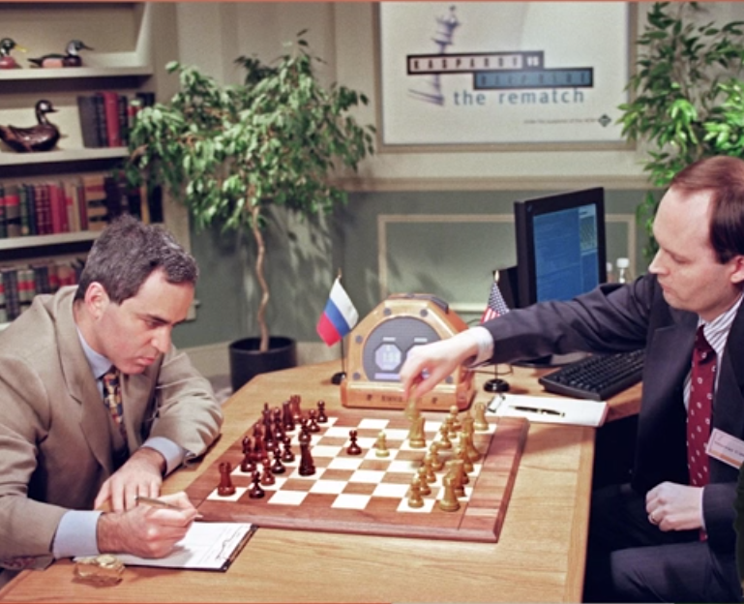
Early Days AI Programs : Deep Blue

Slide 5
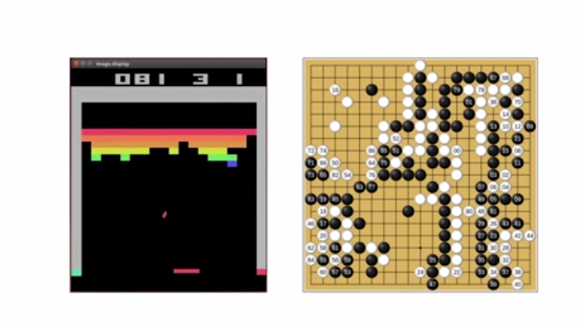
Now, AI Programs
Alpha go is best example, wrote for Playing Go game, but it can play Atari games also.

Slide 6
Machine Learning
Machine Learning does this possible, it is study of algorithms which learns from examples and experience having set of rules and hard coded lines.
“Learns from Examples and Experience”

Slide 7
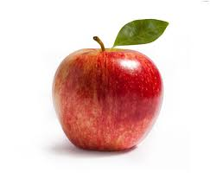
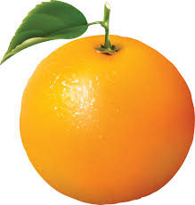
Let's have problem
Let's have problem: It seems easy but difficult to solve without machine learning.

Slide 8

Open Source Libraries

Slide 9
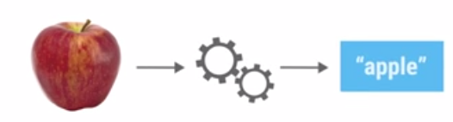

Slide 10
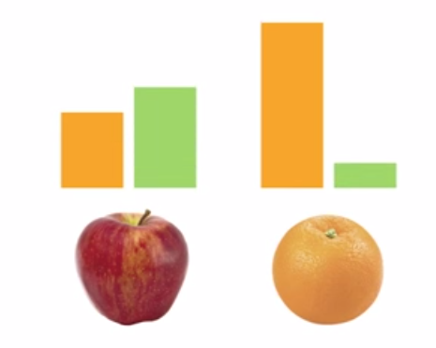

Slide 11
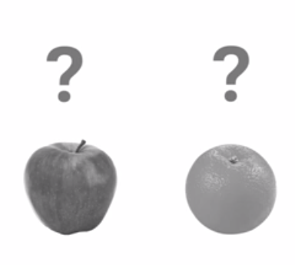

Slide 12
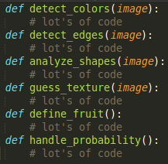

Slide 13
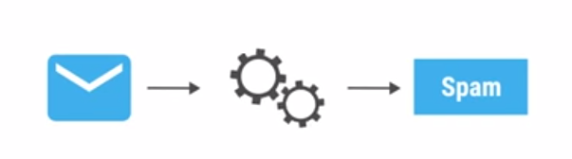
Classifier

Slide 14
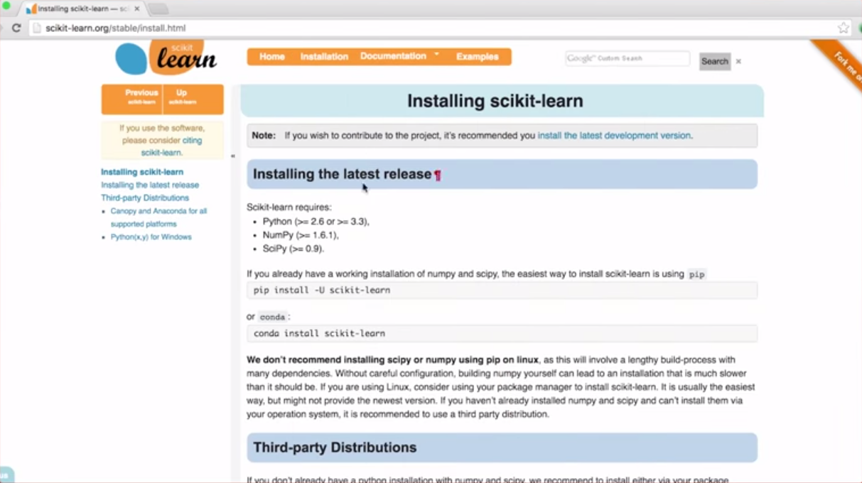
Scikit-learn

Slide 15
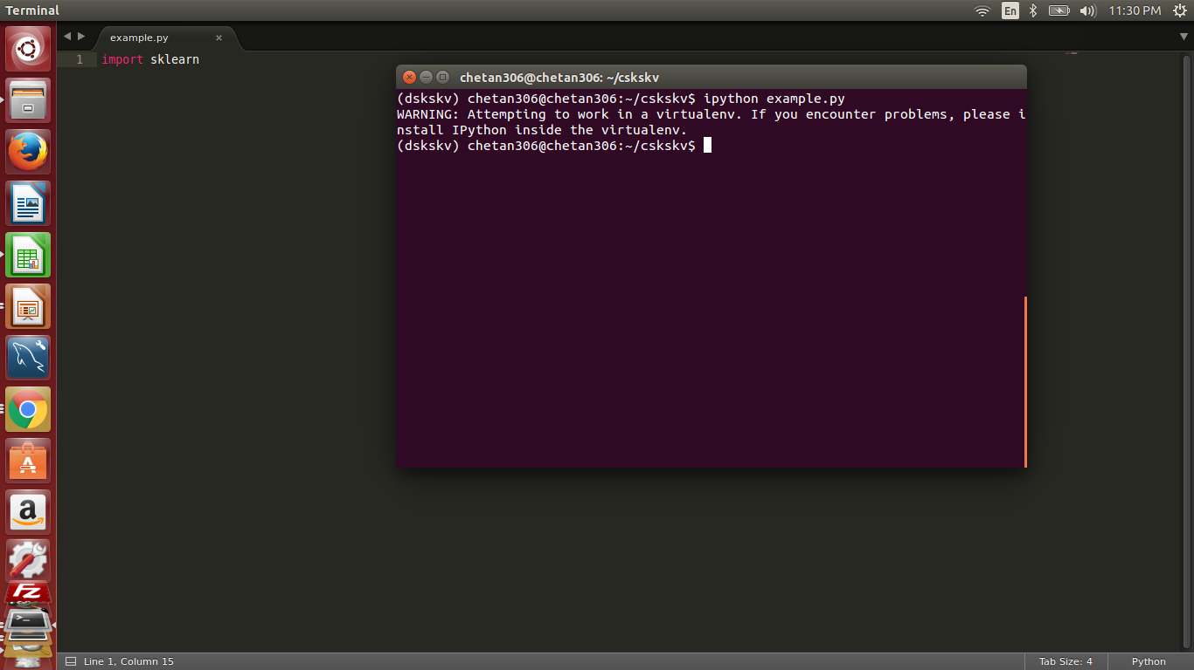
Test ! No error ! Yay !!

Slide 16
Supervised Learning
Collecting
Training
Data
Train
Classifier
Make
Predictions

Slide 17
Training Data
Weight | Texture | Label
150g | Bumpy | Orange
170g | Bumpy | Orange
140g | Smooth | Apple
130g | Smooth | Apple
Examples
Features

Slide 18
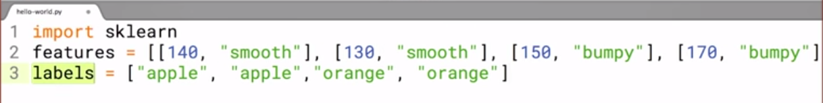

Slide 19
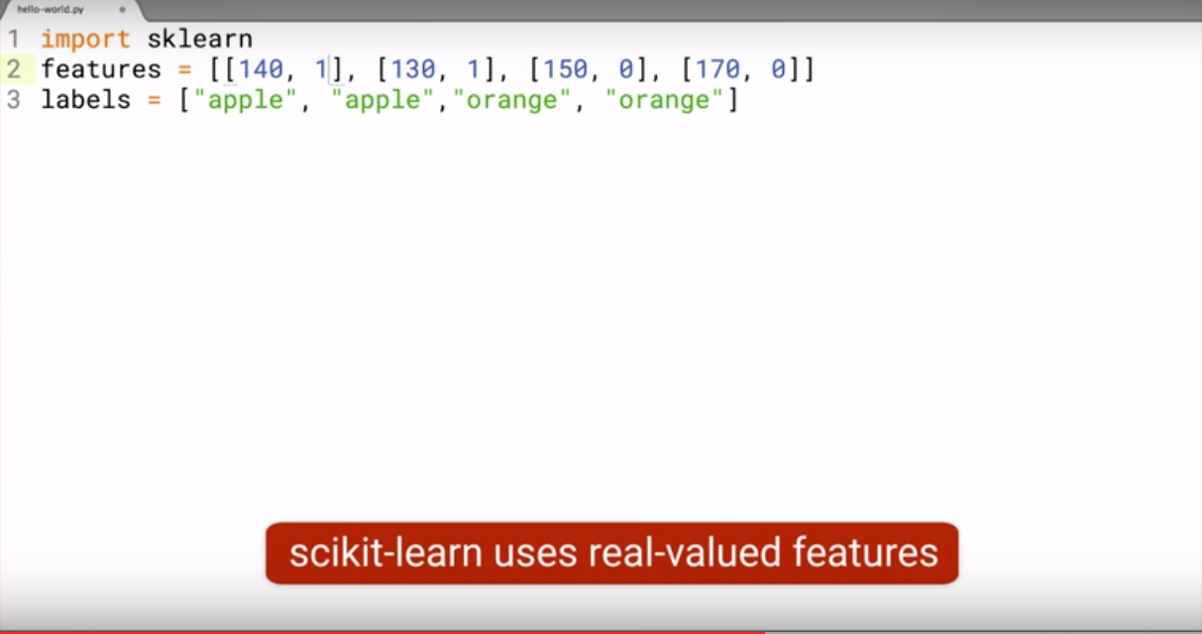

Slide 20
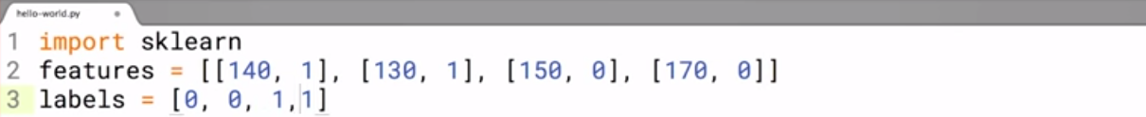

Slide 21
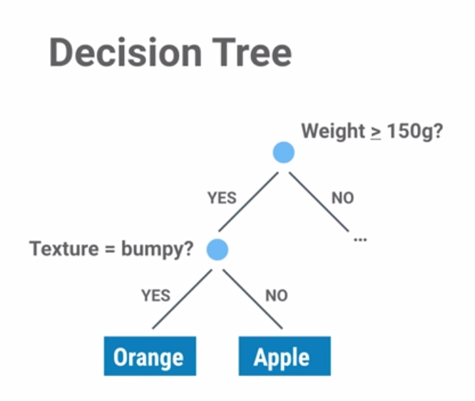

Slide 22
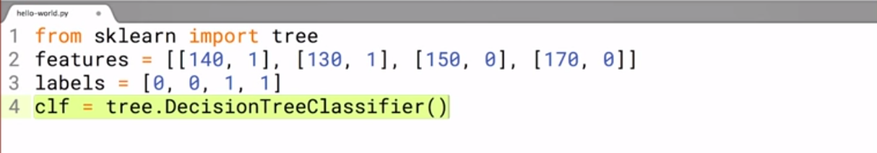

Slide 23
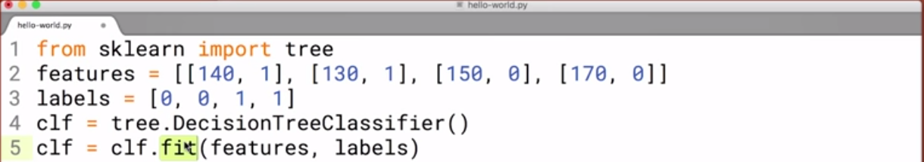
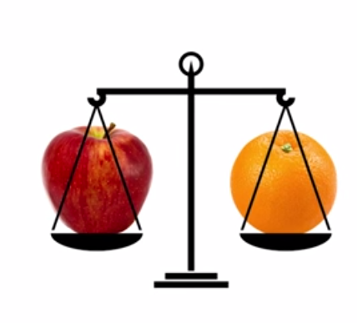

Slide 24
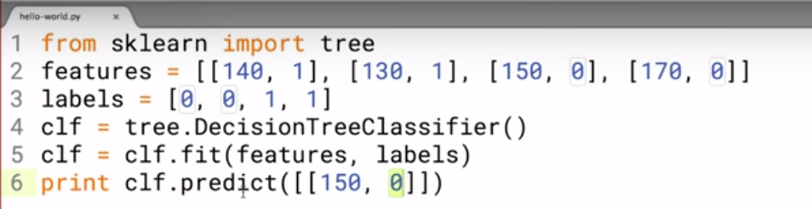

Slide 25


Slide 26
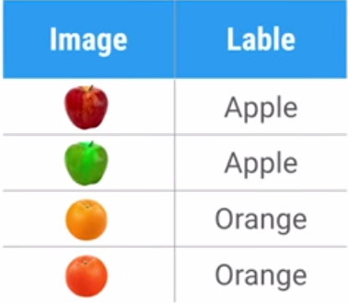
Training Data

Slide 27
Important Concepts
How does this work in Real world ?
How much training data do you need ?
How is the tree created ?
What makes a good feature ?

Slide 28
Many Types of Classifier
Artificial Neural Network (ANN)
Support Vector Machine (SVM)
Nearest Neighbour classifier (KNN)
Random Forest (RF)
Gradient Boosting Machine (GBM)
Etc..
Etc..

Slide 29
Demo

Slide 30
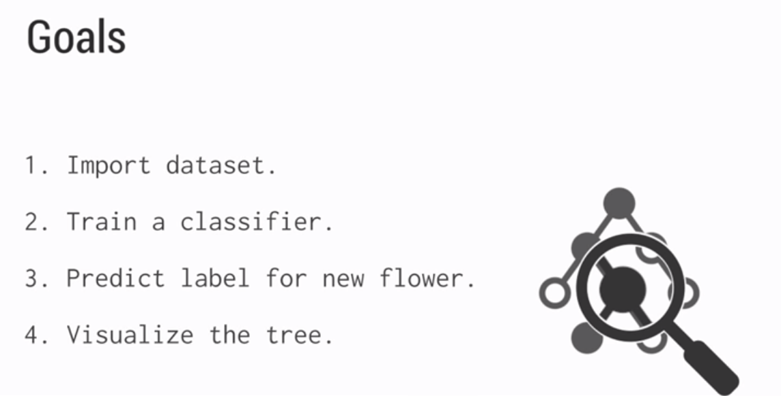
2. Visualizing a Decision Tree

Slide 31
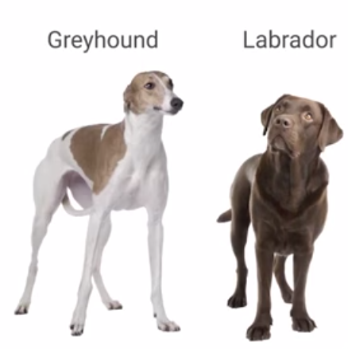
3. What Makes a Good Feature?
Imagine we want to write classifier to classify two types of dogs.

Slide 32
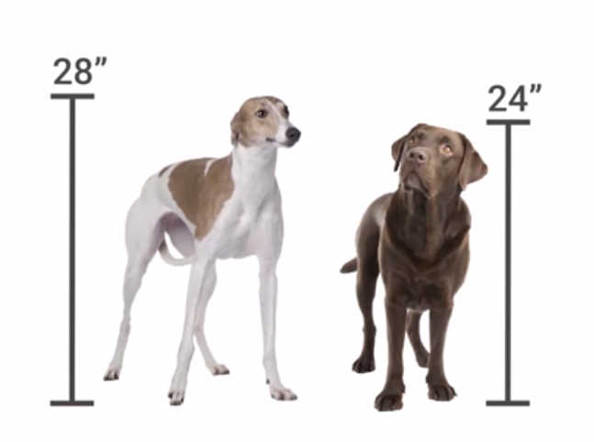

Slide 33
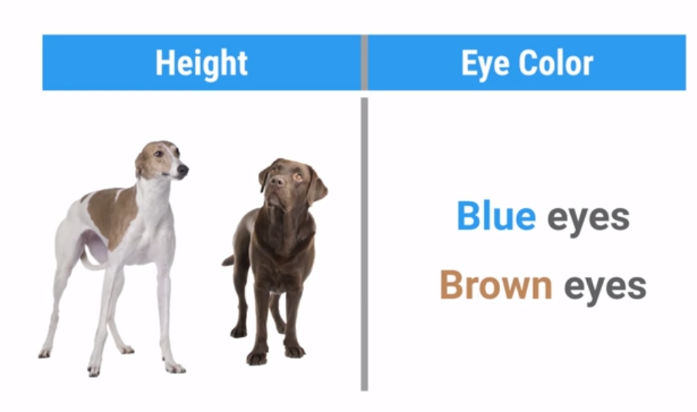

Slide 34
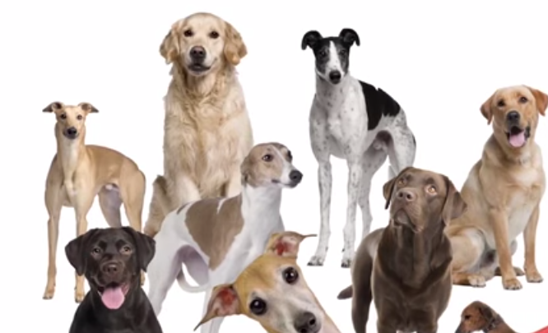
Variation in the world !

Slide 35
Hands - On

Slide 36

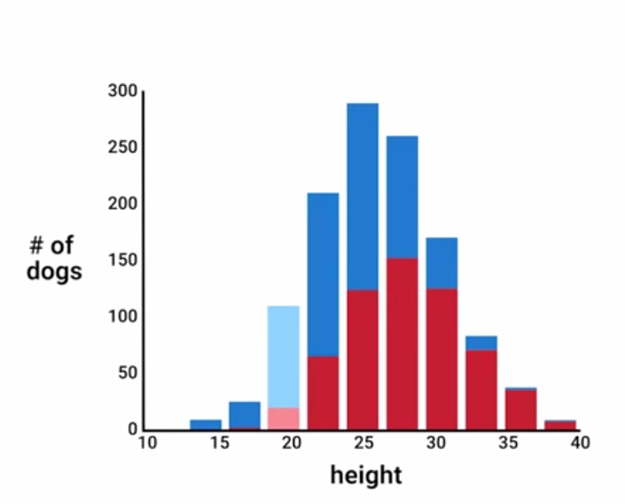

Slide 37
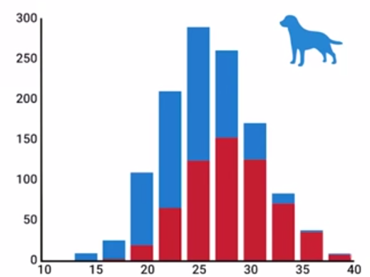
About 80% of dogs at this height are labs

Slide 38
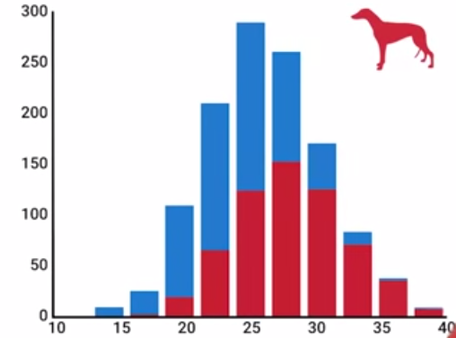
About 95% of dogs at this height are greyhounds

Slide 39
Feature captures different types of information

Slide 40

Thought Experiment

Slide 41


Slide 42


Slide 43


Slide 44


Slide 45
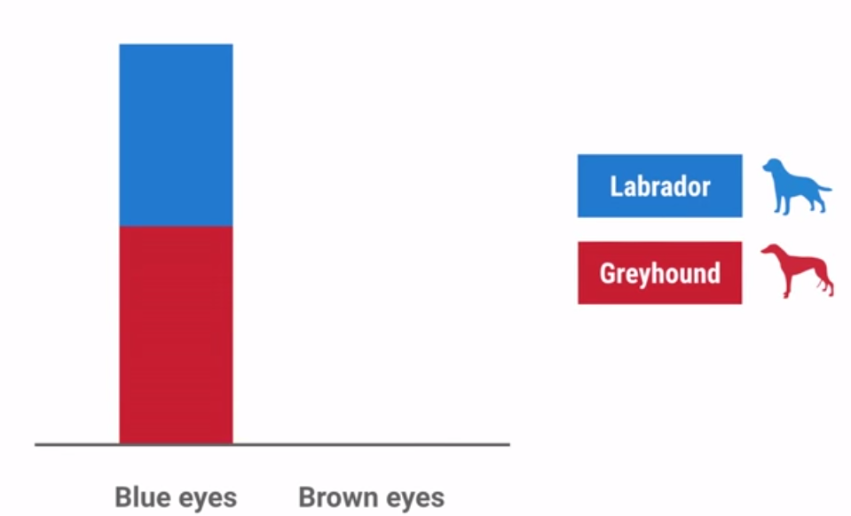

Slide 46

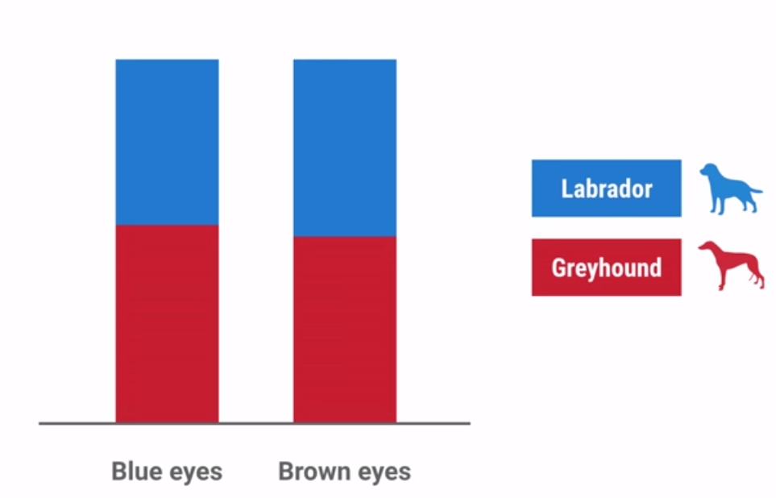
Avoid useless features

Slide 47

Independent features are best

Slide 48
Height in Inches
Height in centimeters

Slide 49
Height in Inches
Height in centimeters

Slide 50
Avoid Redundant features
Feature should be easy to understand

Slide 51
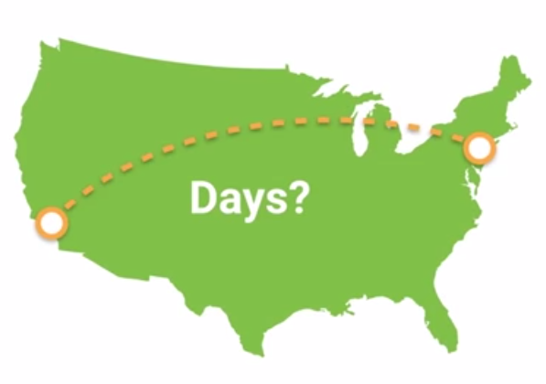

Slide 52


Slide 53
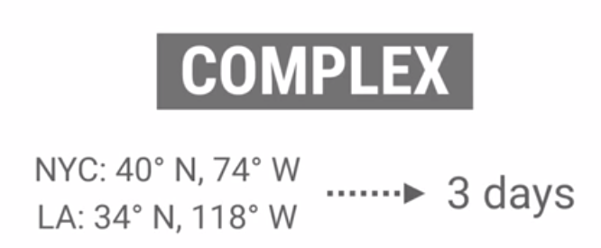

Slide 54
Simpler relationships are easier to learn.
Ideal features are:
Informative
Independent
Simple

Slide 55
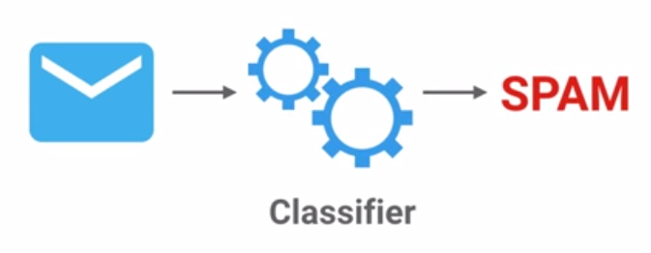
4. Pipeline - Machine Learning

Slide 56
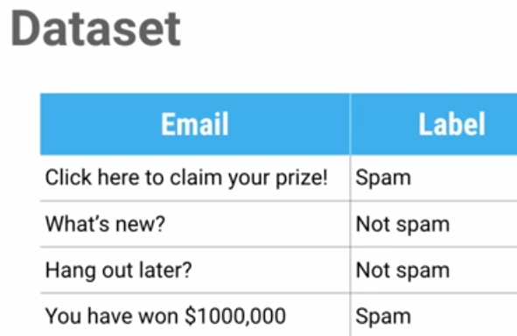

Slide 57
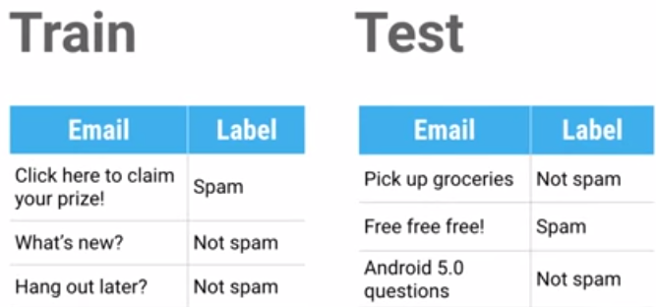

Slide 58
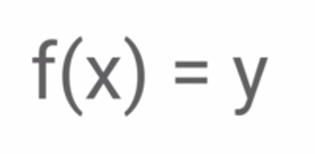

Slide 59
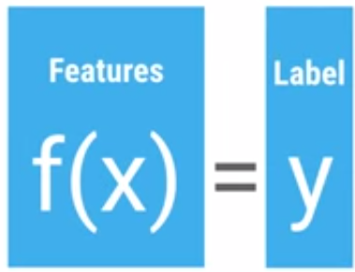

Slide 60
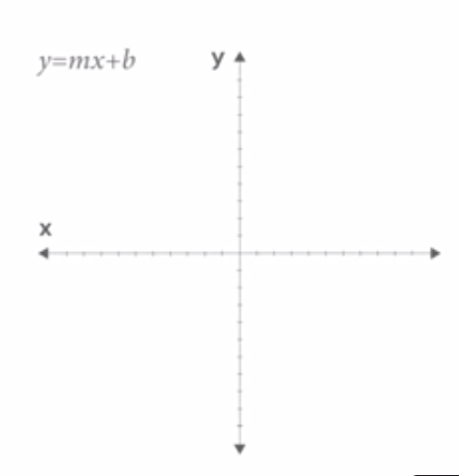
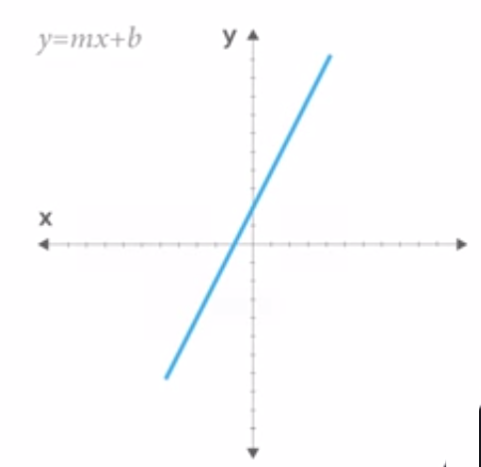

Slide 61
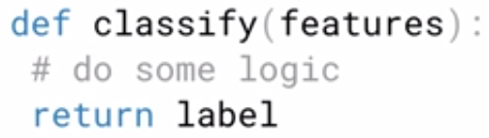

Slide 62
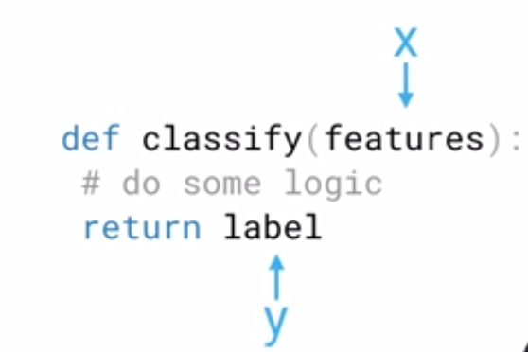

Slide 63
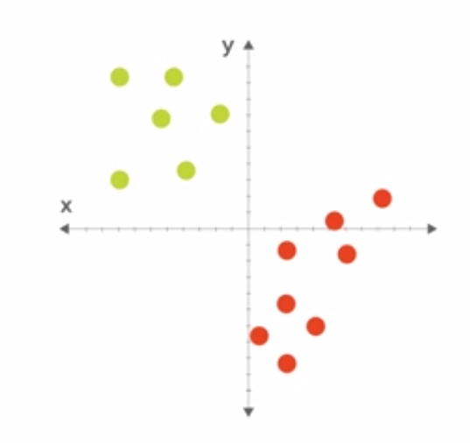

Slide 64
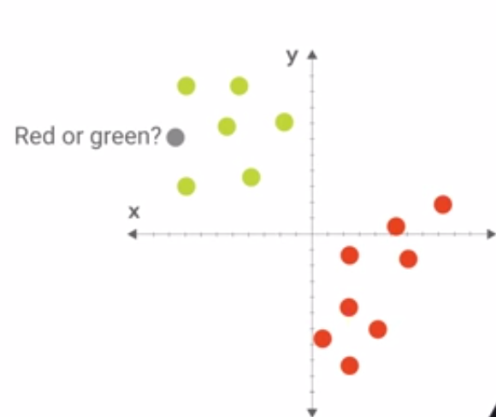

Slide 65
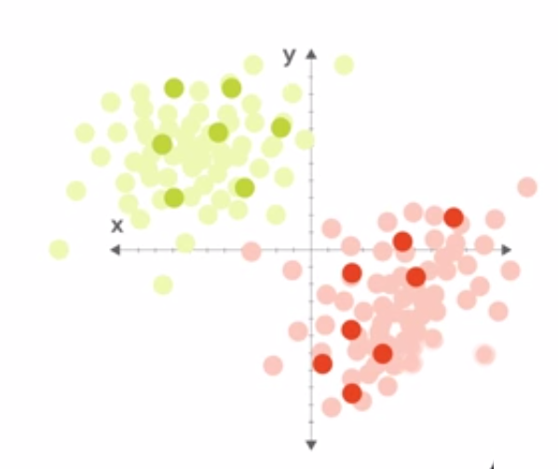

Slide 66
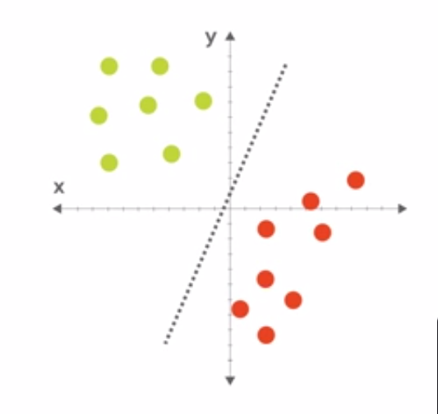

Slide 67
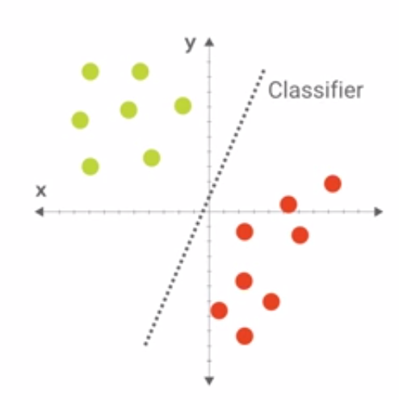

Slide 68
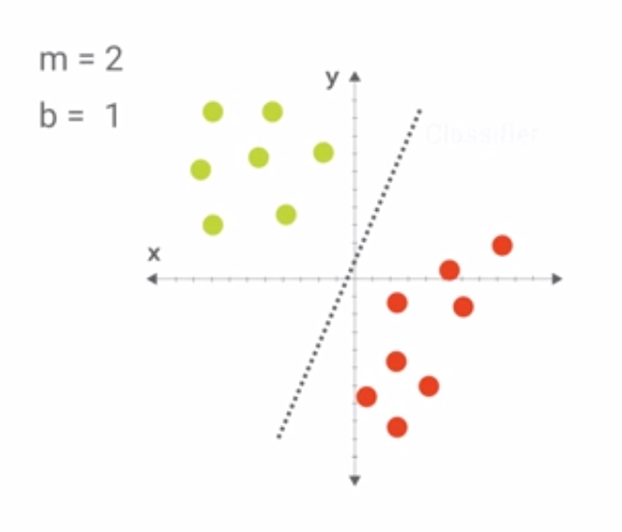

Slide 69
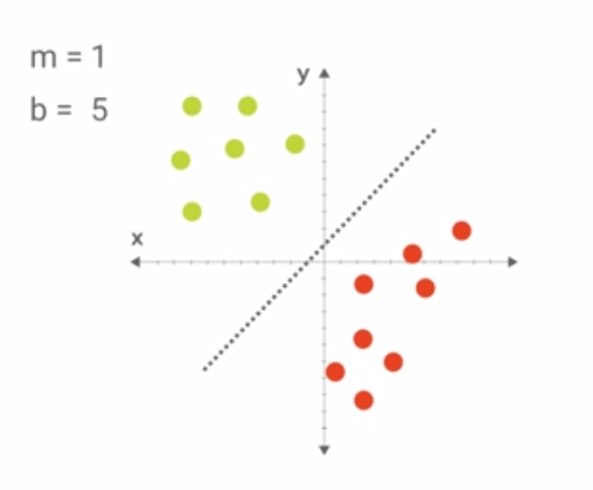

Slide 70
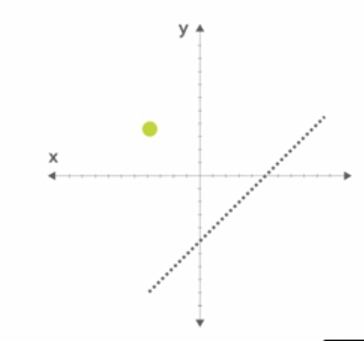

Slide 71
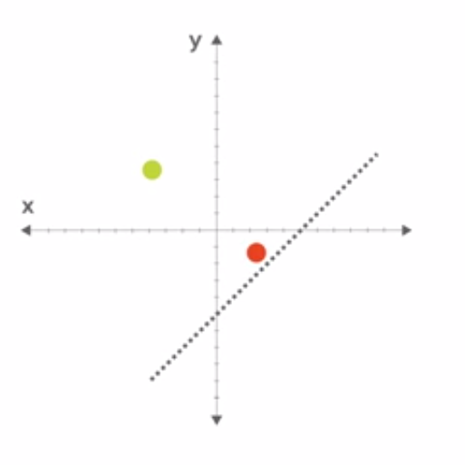

Slide 72


Slide 73
http://playground.tensorflow.org/

Slide 74

5. Writing our first classifier

Slide 75


Slide 76


Slide 77


Slide 78


Slide 79


Slide 80



Slide 81

Measure Distance

Slide 82


Slide 83


Slide 84


Slide 85
Demo
Implement nearest neighbor Algorithm

Slide 86


Next Step

Slide 87


Slide 88


